Slide 1


Slide 2

ADVANCE CONCEPTS
IN FUNCTIONS

Slide 3
The Arrow Function
Arrow functions were introduced with ES6 as a new syntax for writing JavaScript functions
They provide us with an alternative way to write a shorter syntax as compared to the regular function.
Thus we can say that Arrow Functions save a developer’s time and simplify code development

Slide 4
General Syntax
The General Syntax of Arrow Functions is :
(argument1, argument2, ... argumentN) => {
// function body
}
Points to understand:
No function keyword
No function name
A list of arguments within parenthesis, followed by a 'fat arrow' (=>), followed by a function body.

Slide 5
Example
To understand Arrow Function , consider the following example try defining a function which adds two numbers passed as argument and returns their sum:
let add = function(x,y) {
return x + y;
}
console.log(add(10,20)); // will display 30
The same can be done in a more concise way using an Arrow Function as shown in the next slide.

Slide 6
Example
The Arrow Function version of the previous code will be:
let add = (x,y)=> {
return x + y;
} ;
console.log(add(10,20)); // will display 30

Slide 7
More Variations
If the Arrow Function has only one statement, and the statement returns a value, we can remove the braces as well as the return keyword:
For example:
let add = (x,y)=> x + y;
console.log(add(10,20)); // will display 30

Slide 8
More Variations
If the Arrow Function has only one parameter, then we can skip the parentheses as well:
For example:
let square = n => n*n;
console.log(square(10)); // will display 100

Slide 9
PROGRAM
Write an Arrow Function which accepts the radius of a Circle as argument and returns it’s area.

Slide 10
PROGRAM
Write an Arrow Function which accepts a number as argument and returns a message that whether the number is even or odd. Make the function one liner

Slide 11
Restrictions On Arrow Functions
1. Arrow functions do not have their own this value. The value of this inside an Arrow Function is always inherited from the enclosing scope.
For example:
let person = {
fname: "Amit",
age: 21,
toString: () => {
return `${this.fname},${this.age}`;
}
};
document.write(person);
Output: undefined,undefined
Here “this” refers to window object
and not the person object

Slide 12
Restrictions On Arrow Functions
2. In JS , the arguments array in functions is a special object that can be used to get all the arguments passed to the function. But , Arrow Functions do not have arguments array.

Slide 13
Restrictions On Arrow Functions
3. Like anonymous functions , they too are also not hoisted by the
JS Engine

Slide 14
Callback Functions
In JavaScript, all functions are objects, just like Array , Math, Date etc
Thus they have all the features of an object like:
They can be stored in a variable
Like variables they can be passed as arguments to other functions.
Like variables , they can be returned from a function also

Slide 15
Callback Functions
Now, when we apply 2nd point in our code , i.e. when we pass a function as argument to another function , then it is called a CALLBACK FUNCTION and the function that takes another function as a parameter is called a HIGHER ORDER FUNCTION.

Slide 16
General Syntax
<function_1>(<some_arg>,<function_2>);
In the above syntax , we are calling function_1() with some data and the name of another function called function_2 as argument.
Then in function_1() , we might do some initial processing and after that we can call function_2() to run.
function function_1(arg,function_2){
// initial code
function_2();
}

Slide 17
Example
To understand callbacks , let us start with a normal JS function
A regular JS Function:
function multiply(a, b) {
var result = a * b;
console.log("multiply Function Result:",result);
}
multiply(2, 4);
Here we have a simple function which multiplies 2 numbers. We are then calling the function with inputs 2 and 4.

Slide 18
Example
Now imagine if we had to run another operation immediately after multiply computes the result.
This is where we use a callback.
The code on the next slide shows this.

Slide 19
Example
function multiply(a, b, callback) {
var result = a * b;
console.log("multiply Function Result:",result);
callback(result);
}
function checkOddEven(result){
if(result%2==0){
console.log('checkOddEven Function:',result,' is Even');
}
else {
console.log('checkOddEven Function:',result,' is Odd');
}
}
multiply(7, 9, checkOddEven);

Slide 20
Example
Here in the multiply() function, we accept a callback as well as the input.
When we call the multiply() function we pass callback as checkOddEven.
So basically a callback is nothing but a function.
checkOddEven is a function which checks whether a number is odd or even.

Slide 21
Example
In the multiply() function, at the end, we have callback(result).
This is where we ask the callback function to execute.
So in the above code, the sequence is as follows
1. First we call the multiply() function and pass checkOddEven as the callback
2. The multiply() function executes and computes the multiplication result
3. Once the result is calculated, multiply() function asks the callback to execute.
4. In this case, the callback is checkOddEven function.
5. So checkOddEven function will execute.

Slide 22
Anonymous Functions As Callbacks
Another way of passing a callback is by using anonymous functions as shown below:
Example:
function multiply(a, b, callback) {
var result = a * b;
console.log("multiply Function Result:", result);
callback(result);
}
multiply(-7, 9, function(result) {
if (result > 0) {
console.log('checkPosNeg Function:', result, ' is Positive');
}
else {
console.log('checkPosNeg Function:', result, ' is Negative');
}
});

Slide 23
PROGRAM
Write an High Order Function called area() which accepts the radius of a Circle as argument and a callback function which displays area. Then from area() calculate the area and call the callback to display area

Slide 24
PROGRAM
Rewrite the setInterval() example using anonymous function as callback

Slide 25
PROGRAM
Rewrite the array sorting code so that your code now sorts the array of numbers in ascending order

Slide 26
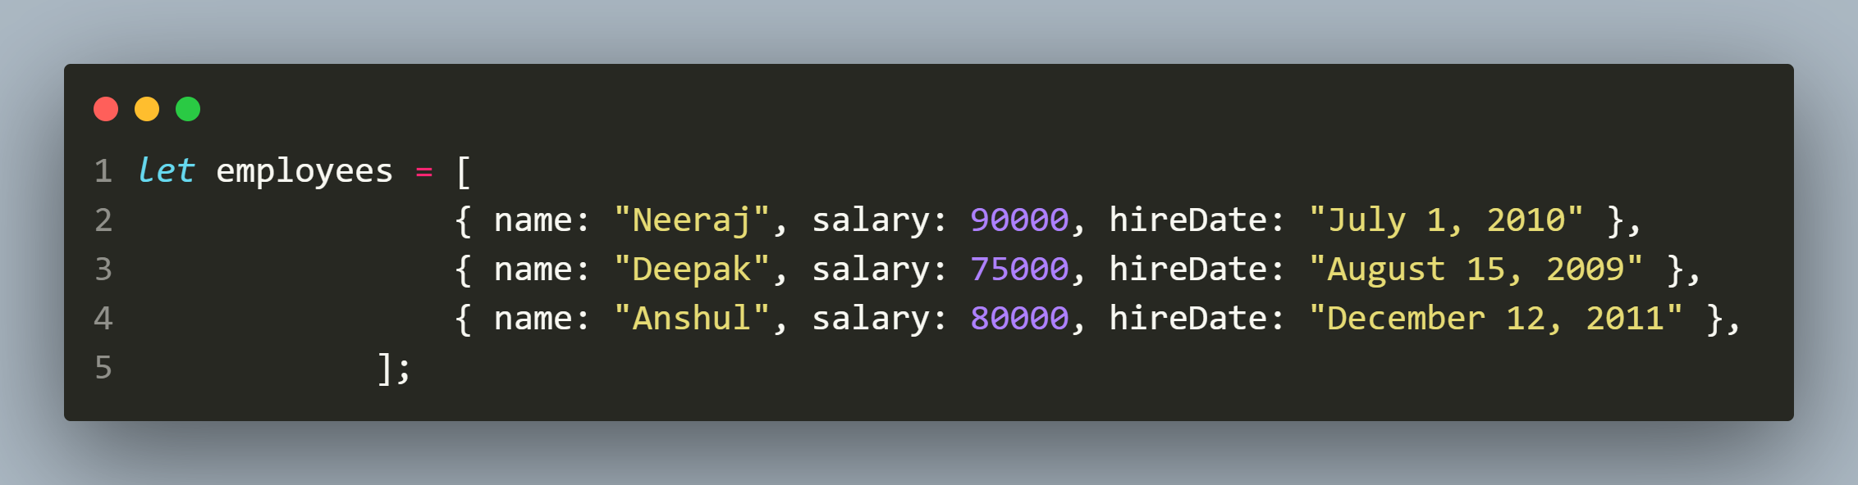
ASSIGNMENT
Sort the following array of employees in descending order of their salary

Slide 27
Arrow Functions As Callbacks
If we prefer, then we can also write the same callback function as an ES6 Arrow Function
Example:
function multiply(a, b, callback) {
var result = a * b;
console.log("multiply Function Result:", result);
callback(result);
}
multiply(-7, 9, (result)=> {
if (result > 0) {
console.log('checkPosNeg Function:', result, ' is Positive');
}
else {
console.log('checkPosNeg Function:', result, ' is Negative');
}
});

Slide 28
Why We Need Callback ?
JavaScript runs code sequentially in top-down order.
However, there are some cases that a piece of code must run after something else happens and also not sequentially.
This is called Asynchronous Programming.
Callbacks make sure that a function is not going to run before a task is completed but will run right after the task has completed.
It helps us develop asynchronous JavaScript code and keeps us safe from problems and errors.

Slide 29
The forEach() Method
Typically, when we want to access every element of an array, we use a for loop statement, as shown below:
let ranks = ['A', 'B', 'C'];
for (let i = 0; i < ranks.length; i++) {
console.log(ranks[i]);
}

Slide 30
The forEach() Method
However, JS provides a much simpler way to iterate over each element of the array .
This is done using the forEach() method in Javascript

Slide 31
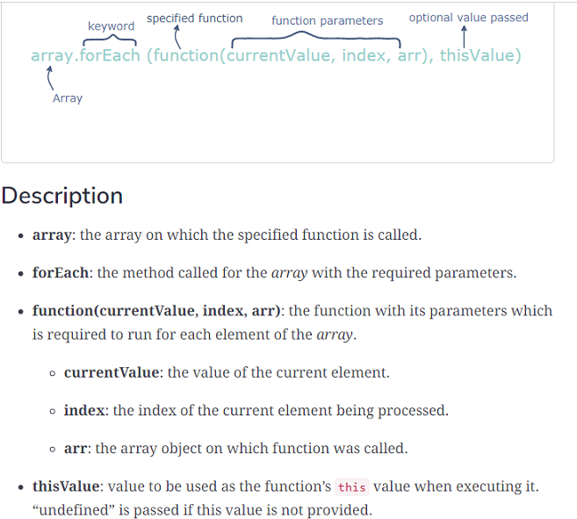
The forEach() Method

Slide 32
Example
let ranks = ['A', 'B', 'C'];
ranks.forEach(function (e) {
console.log(e);
});

Slide 33
Accessing Index
We also can access the index of the current array element as JS passes the index also as second argument to the callback function
Example:
let ranks = ['A', 'B', 'C'];
ranks.forEach(function (e,i) {
console.log(i,e);
});

